Slide 1


tAl
Foundations of Strength
UNDERSTANDING THE SCIENTIFIC FRAMEWORK AND BENEFITS OF STRENGTH TRAINING

Slide 2
LEARNING OBJECTIVES
Understand what evidence-based strength training is
Recognize why strength training is important and beneficial
Identify who can benefit from strength training
2
Credit to
8

Slide 3
WHAT IS STRENGTH TRAINING?
Foundations of evidence-based resistance training
3
Credit to

Slide 4

DEFINITIONS
RESISTANCE TRAINING
Any exercise that requires a muscle to overcome or resist an opposing force
PROGRAM
A fixed group of exercises, sets and repetitions
MAXIMAL STRENGTH (1RM)
The maximum force a muscle can exert in a single
maximal voluntary contraction (MVC)
Fisher, James & Steele, James & Bruce-Low, Stewart & Smith, Dave. (2011). Evidence-Based Resistance Training Recommendations. Medicina Sportiva. 15. 147-162. 10.2478/v10036-011-0025-x.
4
Credit to
4

Slide 5
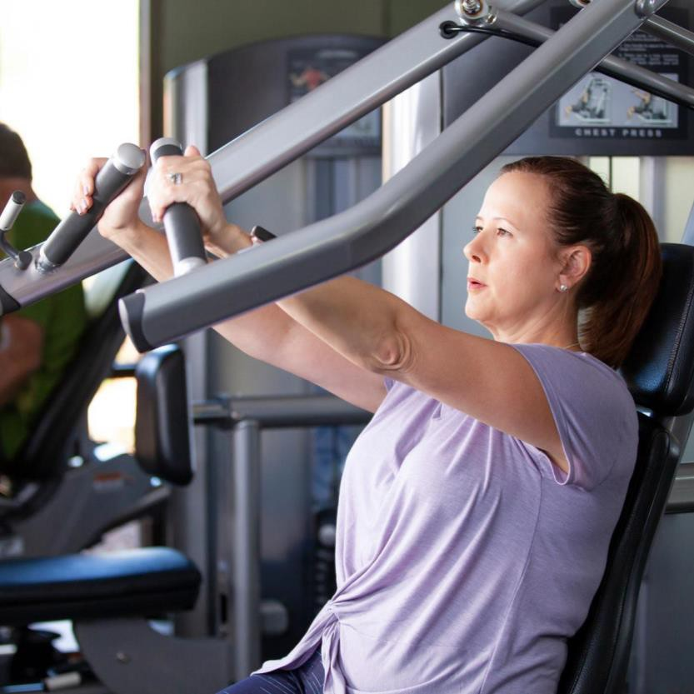
EVIDENCE BASED RECOMMENDATIONS
GENERAL RECOMMENDATIONS
Reps: 5-12
Sets: 1-5
Rest: 2-3mins (per muscle group)
Intensity: 60-90% 1RM
Minimally once a week
Optimal is two to four times per week
No significant evidence of technology to aid improvement of strength long term
Fisher, J., Steele, J., Bruce-Low, S., &amp; Smith, D. (2011). Evidence-based resistance training recommendation s. Medicina Sportiva, 15(3), 147–162. https://doi.org/10.2478/v10036-011-0025-x
Lasevicius, T., Schoenfeld, B. J., Silva-Batista, C., Barros, T. S., Aihara, A. Y., Brend on, H., Lo ngo, A. R., Tricoli, V., Peres, B. A., & Teixeira, E. L. (2019). Muscle Failure Promotes Greater Muscle Hypertro phy in Low-Load but Not in High-Load Resistance Trainin g. Journal of strength and conditioning research, 10.1519/JSC.0000000000003454. Advance onl ine publication.
5
Credit to
https://doi.org/10.1519/JSC.0000000000003454
11

Slide 6
MOVEMENT ACTIVITY #1
Movement patterns
6
Credit to

Slide 7

BASIC MOVEMENT PATTERNS
And progressions and regressions for each
7
Credit to
7

Slide 8
SQUAT
Knee dominant Squats and Lunges
PUSH
Pressing exercises Chest and Shoulder
PULL
Rowing exercises Lat and Back
HINGE
Hip dominant Deadlift and Bridge variations
TWIST
Rotation and Transverse plane
BRACE
Anti movement & trunk/core exercises
GAIT
Walking, running, side stepping, dance, skipping etc.
CARRY
Gait with load Suitcase, Farmer, Waiter
Verkhoshansky, Y., & Siff, M. C. (2009). Supertraining. Verkhoshansky.
8
Credit to
8

Slide 9
BASIC WORKOUT STRUCTURE
Day 1
Squat
Push – Horizontal
Pull – Vertical
Brace – Lateral
Carry – Suitcase
Day 2
Hinge
Push – Vertical
Pull – Horizontal - Uni
Brace – Anti Rotation
Carry – Farmer
Day 3
Hinge – Unilateral
Pull – Horizontal - Bi
Squat – Unilateral
Brace – Linear
Carry – Waiter
9
Credit to
9

Slide 10
WHY IS STRENGTH TRAINING IMPORTANT? Exploring the wide reaching benefits of resistance training
10
Credit to

Slide 11
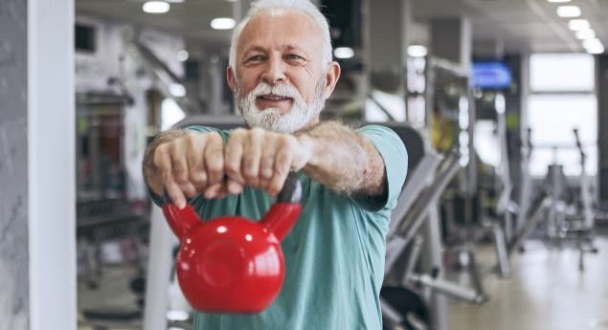

BENEFITS
BIOMARKER IMPROVEMENTS WITH STRENGTH
Body composition (lean mass)
Blood glucose levels
Insulin sensitivity
Blood pressure in persons with prehypertension or stage 1
hypertension
Effective to prevent and treat metabolic syndrome
Garber, C. E., Blissmer, B., Deschenes, M. R., Frankl in, B. A., Lamonte, M. J., Lee, I. M., Nieman, D. C., Swain, D. P., & American College of Sports Medicine (2011). American College of Sports Medicine
position stand. Quantity and quality of exercise for developing and maintaining cardiorespiratory, muscu loskeletal, and neuromoto r fitness in apparently healthy adults: guidance for prescribing
exercise. Medicine and science in sports and exercise, 43(7), 1334–1359. https://doi.org/10.1249/MSS.0b013e318213fefb
Fisher, J., Steele, J., Bruce-Low, S., &amp; Smith, D. (2011). Evidence-based resistance training recommendations. Medicina Sportiva, 15(3), 147–162. https://doi.org/10.2478/v10036-011-0025-x .
11
Credit to
17

Slide 12

BENEFITS
BONE IMPROVEMENTS WITH STRENGTH
Effectively increases bone mass and strength
  Bone mineral density and content
Prevent, slow or even reverse bone mass loss in people with osteoporosis
Reduce the chance of developing osteoarthritis
Reduce pain and disability for persons with osteoarthritis
Garber, C. E., Blissmer, B., Deschenes, M. R., Franklin, B. A., Lamonte, M. J., Lee, I. M., Nieman, D. C., Swain, D. P., & American College of Sports
Medicine (2011). American Co llege of Sports Medicine position stand. Quantity and quality of exercise for developing and maintainin g
cardiorespiratory, musculoskeletal, and neuromotor fitness in apparently healthy adults: guidance for prescribing exercise. Medicine and science in
sports and exercise, 43(7), 1334–1359. https:// doi.o rg/10.1249/MSS.0b013e318213fefb
Fisher, J., Steele, J., Bruce-Low, S., &amp; Smith, D. (2011). Evidence-based resistance training recommendations. Medicina Sportiva, 15(3), 147–
162. https://doi.org/10.2478/v10036-011-0025-x .
12
Credit to
17

Slide 13

BENEFITS
MENTAL HEALTH IMPROVEMENTS
May prevent and improve depression and anxiety
Increase "energy" levels
Decrease fatigue
1. Garber, C. E., Blissmer, B., Deschenes, M. R., Frankl in, B. A., Lamonte, M. J., Lee, I. M., Nieman, D. C. , Swain, D. P., & American Co llege of Sports Medicine (2011). American Coll ege of Sports Medicine position stand. Quantity and quality of exercise for developing and maintaining cardiorespiratory, musculoskeletal, and neuromotor fitness in apparently healthy adults: guidance for prescribing exercise. Medicine and science in sports and exercise, 43(7), 1334–1359. https://doi.org/10.1249/MSS.0b013e318213fefb
2. Fisher, J., Steele, J., Bruce-Low, S., &amp; Smith, D. (2011). Evidence-based resistance training recommendations. Medicina Sportiva, 15(3), 147–162. https://do i.org/10.2478/v10036-011-0025-x .
13
Credit to
17

Slide 14
MOVEMENT ACTIVITY #2
Tri planar movement
14
Credit to

Slide 15
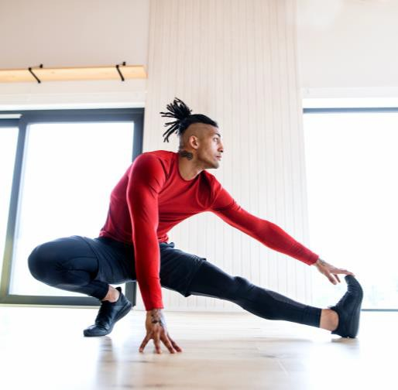

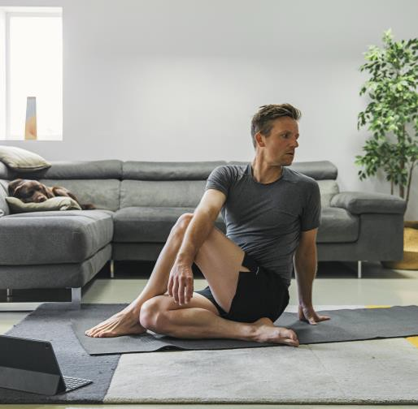
FRONTAL PLANE
SAGITTAL PLANE
TRANSVERSE PLANE
Verkhoshansky, Y., & Siff, M. C. (2009). Supertraining. Verkhoshansky.
15
Credit to
15
17

Slide 16

WHO CAN BENEFIT FROM STRENGTH TRAINING?
Identifying the specific populations that can benefit from a resistance training program
16
Credit to
16
17

Slide 17
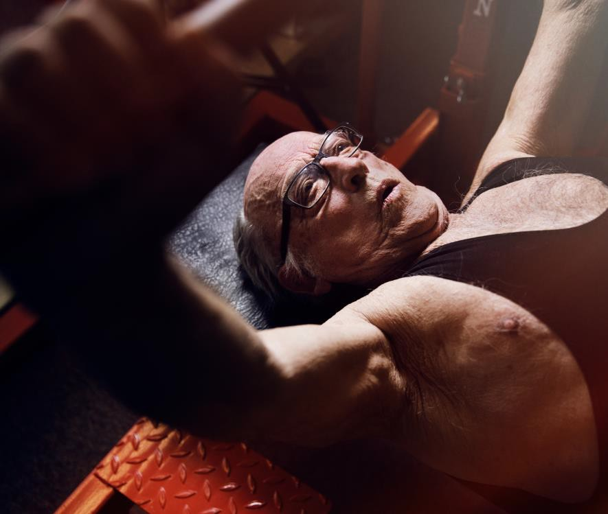
OLDER ADULTS
RESISTANCE TRAINING IS THE MOST POWERFUL INTERVENTION TO COMBAT THE EFFECTS OF AGING & DISEASE
Maintain muscle function and size overcome or slow sarcopenia and frailty
Improve performance of ADL’s
Reduced fall risk, improved balance
Decrease long term disease risk or improvement of managing symptoms
Fragala, M. S., Cadore, E. L., Dorgo, S., Izquierdo, M., Kraemer, W. J., Peterson, M. D., & Ryan, E. D. (2019). Resistance Training for Older Adults: Position Statement From the National Strength and
Co nditioning Association. Journal of strength and conditioning research, 33(8), 2019–2052. https://doi.org/10.1519/JSC.0000000000003230
18
Credit to
17
17

Slide 18
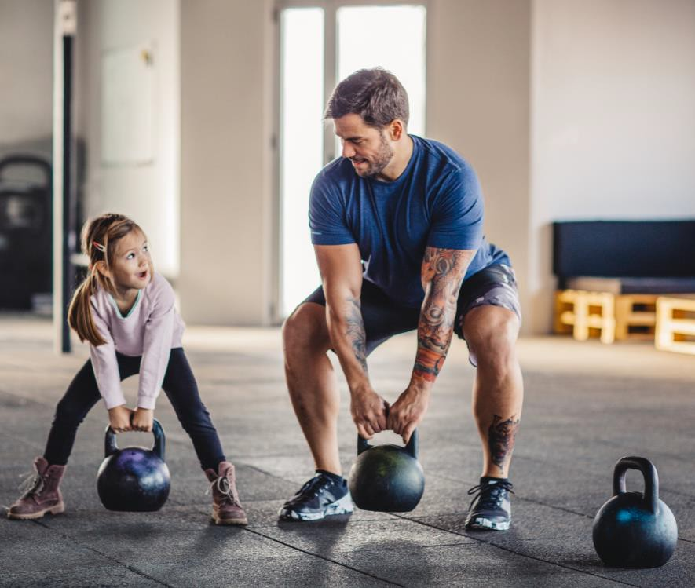
YOUTH & ADOLESCENTS
Strength training does not stunt growth
Variety ,variety,variety
Emphasize technique and quality
Qualified and experienced supervision
Improve risk profile, motor skill performance and more
Faigenbaum, A. D., Kraemer, W. J., Blimkie, C. J., Jeffreys, I. , Micheli, L. J., Nitka, M., & Rowland, T. W. (2009). Youth resistance training: updated position statement paper from the national strength
and cond itio ning association. Journal of strength and conditioning research, 23(5 Suppl), S60–S79. https://doi.org/10.1519/JSC.0b 013e31819df407
19
Credit to
18
17

Slide 19
LEARNING OBJECTIVE REVIEW
Understand what evidence-based strength training is
Recognize why strength training is important and beneficial
Identify who can benefit from strength training
20
Credit to
19
17

Slide 20
QUESTIONS?
Ask me anything!

Slide 21

FOUNDATIONS OF STRENGTH
SERVICES RECOMMENDATIONS
Comprehensive Exercise Assessment
Rx for Exercise
MSK/Joint Assessment
DEXA (not bookable on the app)

Slide 22

Thank you for your time.

