Slide 1


tAl
A Medical Perspective on Longevity

Slide 2
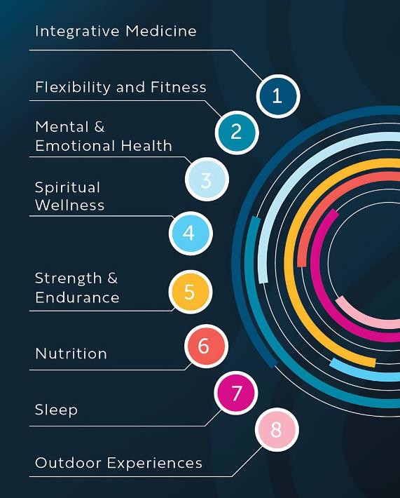
Integrative Medicine
2
Credit to

Slide 3

HEALTHSPAN VS LIFESPAN
Lifespan: The total life lived.
Healthspan: The period free from disease.
The World Health Organization (WHO) has expanded it to “a state of complete physical, mental and social well-being and not merely the absence of disease or infirmity”.
Healthspan-lifespan gap is estimated at around 9 years
Garmany A, Yamada S, Terzic A. Longevity leap: mind the healthspan gap. NPJ Regen Med. 2021 Sep 23;6(1):57.
3
Credit to

Slide 4
LONGEVITY
Since 2018, more people are over 65 than there are children under 5
If this trend continues, by the year 2050, the number of people over 65 will be double the number under 5
Lorenzini A, et al., Editorial: Adipose Tissue : Which role in Aging and Longevity? Fron Endocrinol 2020 Aug 25; 11:583
4
Credit to

Slide 5
GENETICS
A Danish twin study found that genetics accounted for approximately 25 percent of the variation in longevity among twins and environmental factors accounted for approximately 50 percent. However, with greater longevity (to age 90 or 100), genetic influences became more important.
Lorenzini A, et al., Editorial: Adipose Tissue : Which role in Aging and Longevity? Fron Endocrinol 2020 Aug 25; 11:583
5
Credit to

Slide 6
LIFE EXPECTANCY IN MEN & WOMEN
Life expectancy gap between women and men is the largest it has been since 1996.
The life expectancy gap between men and women widened to 5.8 years in that time span, up from 4.8 years in 2010.
Overall life expectancy decreased from 78.8 years in 2019 to 77 years in 2020 and to 76.1 years in 2021.
Yan B, et al. JAMA Intern Med. 2023;doi:10.1001/jamainternmed.2023.6041.
6
Credit to

Slide 7
THE LARGEST CONTRIBUTORS OF WORSENING LIFE EXPECTANCY IN MEN COMPARED WITH WOMEN BEFORE THE COVID-19 PANDEMIC INCLUDED:
Unintentional injuries (0.23 years)
Diabetes (0.05 years)
Suicide (0.04 years)
Homicide (0.03 years)
Heart disease (0.03 years)
7
Credit to

Slide 8


SUCCESSFUL AGING
Successful aging identifies older individuals who are free from chronic disease and continue to function well into old age, both physically and cognitively. Longitudinal study of nearly 6000 British civil service employees followed for 17 years, successful aging was identified in 12.8 percent of men and 14.6 percent of women at follow-up. The strongest predictor of successful aging was socioeconomic status at midlife. After adjustment for socioeconomics, not smoking, diet, exercise, moderate alcohol intake, and work support, predicted healthy aging.⁽¹⁾
Successful aging: the contribution of early-life and midlife risk factors.AUBritton A, Shipley M, Singh-Manoux A, Marmot MG SOJ Am Geriatr Soc.
2008;56(6):1098. Epub 2008 May 12.
8
Credit to

Slide 9

PERSONALITY AND MORTALITY
In 2013 in the American Journal of Epidemiology, Meta-analysis of 76,150 participants from 7 cohorts. They examined associations between five personality traits (extraversion, neuroticism, agreeableness, conscientiousness, and openness to experience) and the risk of death from all causes.
Only low conscientiousness (a tendency to give up easily, a lack of self-control, and poor long-term planning) was associated with elevated mortality.
Jokela M, Batty GD, Nyberg ST, Virtanen M, Nabi H, Singh-Manoux A, Kivimäki M. Personality and all-cause mortality : individual-participant
meta-analy sis of 3,947 deaths in 76,150 adults. Am J Epidemiol. 2013 Sep 1;178(5):667-75.
9
Credit to

Slide 10
CAUSES OF EARLY
MORTALITY IN THE U.S.
1 . SMOKING
Current smokers and those with a history of smoking had the greatest risk of early mortality. CDC states: Smoking cigarettes causes over 480,000 deaths per year in the U.S., including more than 41,000 deaths due to second hand smoke. Smokers die approximately 10 years sooner than non-smokers.
2 . ALCOHOL ABUSE
The National Institute on Alcohol Abuse and Alcoholism reports an estimated 88,000 people (approx. 62,000 men and 26,000 women) die from alcohol-related causes annually. There are around 200 types of disorders and injuries that alcohol has a role in which can cause death, as reported by the World Health Organization (WHO).
3 . PHYSICAL INACTIVITY
In the US per the CDC about 1 in 7 adults are physically inactive. A 2018 CDC study found that a significant portion of deaths among adults aged 40 -69 years (9.9 percent) and adults over 70 (7.8 percent) can be attributed to physical inactivity.
10
Credit to

Slide 11
CAUSES OF EARLY
MORTALITY IN THE U.S.
4 . FINANCIAL STRESS
A 2014 study published in BMC (BioMed Central) Public Health looked at financial stress in late adulthood which includes lower wealth, unemployment history and reported financial difficulties, increases the risks of cardiovascular disease and all-cause mortality, particularly among men.
5 . ADVERSE EVENTS:
Physical abuse, sexual abuse, emotional abuse, neglect, witnessing household domestic violence, substance abuse, mental illness, parental incarceration, separation or divorce, experiencing racism, and poverty all cause stress and may have lifelong consequences for both mental and physical health.
Carlsson AC, Starrin B, Gigante B, Leande r K, Hellenius ML, de Faire U. Financial stress in late adulthood and diverse risks of incident cardiov ascular disease and all-
cause mortality in women and men. BMC Public Health. 2014 Jan 9;14:17.
11
Credit to

Slide 12

AGING BY
ORGAN SYSTEMS
12
Credit to

Slide 13
“AGING IS NOT ABOUT QUITTING. IT’S ABOUT ADJUSTING”
13
Credit to

Slide 14

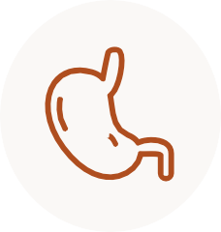
HEMATOPOIETIC SYSTEM
GASTROINTESTINAL
SYSTEM
RENAL
SYSTEM
Bone marrow reserves are reduced, therefore there is a delayed response to blood loss or hypoxia. White blood cell impairment increases infection risk and increased risk for myelotoxicity from chemotherapy. Advancing age leads to a procoagulant state.
Reflux esophagitis (due to altered contractions and sphincter tone) is common with age. Helicobacter pylori infection is common, and increased sensitivity to gastric irritants such as NSAIDs. Motility changes resulting in constipation, increased colon diverticula and increased risk for colon cancer.
Function declines, the older kidney is more prone to kidney toxicity from medications or intravenous contrast.
14
Credit to

Slide 15
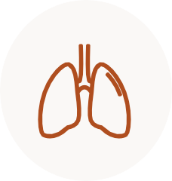
CARDIOVASCULAR
SYSTEM
RESPIRATORY
SYSTEM
GENITOURINARY
SYSTEM
Increases risk for hypertension, coronary artery disease. Decrease in maximum heart rate, and decreased left ventricular ejection fraction (LVEF) to exercise. Aortic and mitral valve thicken, often with valvular calcific deposits.
Approximately one-third of surface area per volume of lung tissue is lost over the lifespan.
Aging increases the older person’s risk of urinary incontinence, urinary tract infection, erectile dysfunction and dyspareunia.
15
Credit to

Slide 16
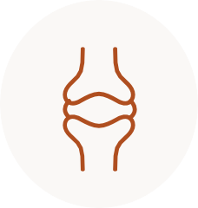
SENSORY
SYSTEM
SKIN
MUSCULOSKELETAL
SYSTEM
Presbyopia, farsighted, is due to changes in the lens and iris. Auditory system: high-frequency hearing loss and impaired speech recognition in noisy environments. Loss of taste (due to decreased olfaction rather than taste)
The normal aging of the skin leads to atrophy, decreased elasticity and impaired metabolic and reparative responses. Photoaging, not physiologic aging, produces 90 percent of changes in skin.
Muscle mass decreases, leading to impaired motility and balance. Increased fracture risk and slower rate of fracture repair.
16
Credit to

Slide 17

INFLAMMAGEING
Age-related increase in the levels of pro-inflammatory markers in blood and tissues
Ferrucci L, Fabbri E. Inflammageing: chronic inflammation in ageing, cardiovascular disease, and frailty. Nat Rev Cardiol. 2018 Sep;15(9):505-522.
17
Credit to

Slide 18
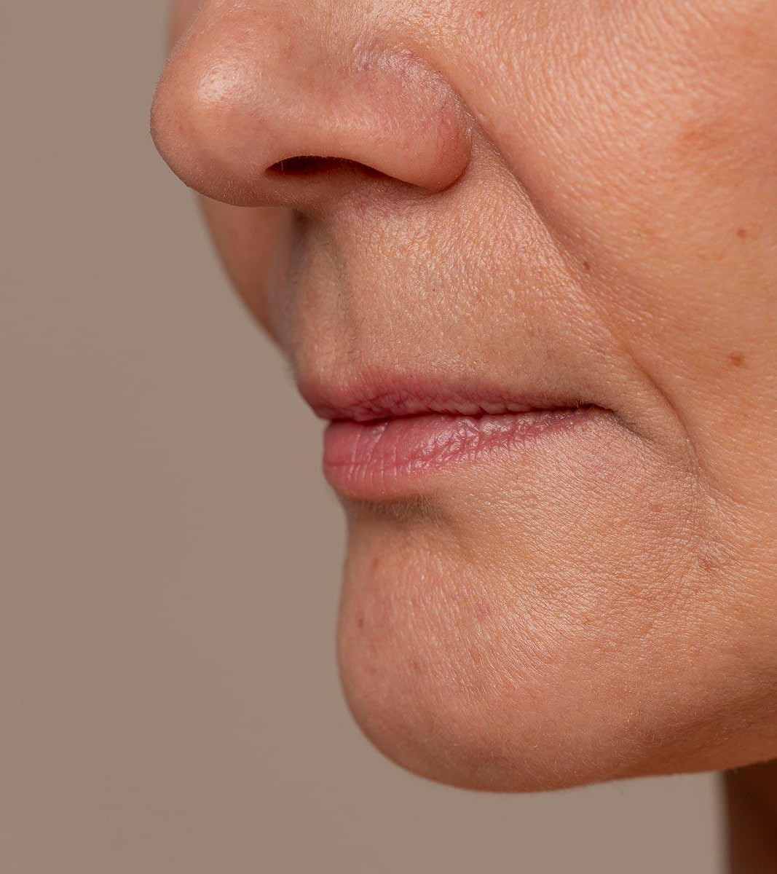

INFLAMMAGEING
Potential mechanisms of inflammageing include:
Central obesity
Genetic susceptibility
Increased gut permeability
Changes to microbiota composition
Ferrucci L, Fabbri E. Inflammageing: chronic inflammation in ageing, cardiovascular disease, and frailty. Nat Rev Cardiol. 2018 Sep;15(9):505-522.
18
Credit to

Slide 19

PREVENTION OF CHRONIC DISEASE
 | Heart (CAD) | Dementia | Cancer | Diabetes | Stroke
Smoking | × | × | × |  | ×
Inflammation | × | × | × | × | ×
Stress | × |  | × | × | ×
Obesity (central) | × | × | × | × | ×
Inactivity | × | × | × | × | ×
Cholesterol | × | × |  |  | ×
Sleep | × | × | × | × | ×
HTN | × | × |  |  | ×
Insulin Resistance | × | × | × | × | ×
19
Credit to

Slide 20

APPLYING YOUR CGM
20
Credit to

Slide 21

DOWNLOAD APP ON YOUR SMART PHONE
21
Credit to

Slide 22
REFERENCES
Vogels N, Egger G, Plasqui G, Westerterp KR. Estimating changes in daily physical activity levels over time: implication for health interventions from a novel approach. Int J Sports Med. 2004
Nov;25(8):607-10. doi: 10.1055/s-2004-820950. PMID: 15532004.
Piercy KL, Troiano RP, Ballard RM, et al. The Physical Activity Guidelines for Americans. JAMA. 2018;320(19):2020–2028. doi:10.1001/jama.2018.14854
Schmitz KH, Stout NL, Maitin-Shepard M, Campbell A, Schwartz AL, Grimmett C, Meyerhardt JA, Sokolof JM. Moving through cancer: Setting the agenda to make exercise standard in
oncology practice. Cancer. 2021 Feb 1;127(3):476-484. doi: 10.1002/cncr.33245. Epub 2020 Oct 22. PMID: 33090477; PMCID: PMC7899181.
Del Pozo Cruz B, Ahmadi MN, Lee IM, Stamatakis E. Prospective Associations of Daily Step Counts and Intensity With Cancer and Cardiovascular Disease Incidence and Mortalityand All-
Cause Mortality. JAMA Intern Med. 2022 Sep 12:e224000. doi: 10.1001/jamainternmed.2022.4000. Epub ahead of print. PMID: 36094529; PMCID: PMC9468953.
Aya V, Flórez A, Perez L, Ramírez JD. Association between physical activity and changes in intestinal microbiota composition: A systematic review. PLoS One. 2021 Feb 25;16(2):e0247039.
doi: 10.1371/journal.pone.0247039. PMID: 33630874; PMCID: PMC7906424.
Gomes-Osman J, Cabral DF, Morris TP, McInerney K, Cahalin LP, Rundek T, Oliveira A, Pascual-Leone A. Exercise for cognitive brain health in aging: A systematic review for an evaluation of
dose. Neurol Clin Pract. 2018 Jun;8(3):257-265. doi: 10.1212/CPJ.0000000000000460. PMID: 30105166; PMCID: PMC6075983.
Del Pozo Cruz B, Ahmadi MN, Lee IM, Stamatakis E. Prospective Associations of Daily Step Counts and Intensity With Cancer and Cardiovascular Disease Incidence and Mortalityand All-Cause Mortality. JAMA Intern Med. 2022 Sep 12:e224000. doi: 10.1001/jamainternmed.2022.4000. Epub ahead of print. PMID: 36094529; PMCID: PMC9468953.
Li Q, Morimoto K, Nakadai A, Inagaki H, Katsumata M, Shimizu T, Hirata Y, Hirata K, Suzuki H, Miyazaki Y, Kagawa T, Koyama Y, Ohira T, Takayama N, Krensky AM, Kawada T. Forest bathing enhances human natural killer activity and expression of anti-cancer proteins. Int J Immunopathol Pharmacol. 2007 Apr-Jun;20(2 Suppl 2):3-8. doi: 10.1177/03946320070200S202. PMID: 17903349.
Park BJ, Tsunetsugu Y, Kasetani T, Kagawa T, Miyazaki Y. The physiological effects of Shinrin-yoku (taking in the forest atmosphere or forest bathing): evidence from field experiments in 24
forests across Japan. Environ Health Prev Med. 2010 Jan;15(1):18-26. doi: 10.1007/s12199-009-0086-9. PMID: 19568835; PMCID: PMC2793346.
White, M.P., Alcock, I., Grellier, J. et al. Spending at least 120 minutes a week in nature is associated with good health and wellbeing. Sci Rep 9, 7730 (2019). https://doi.org/10.1038/s41598-019-44097-3
Valeria Vitale, Leanne Martin, Mathew P. White, Lewis R. Elliott, Kayleigh J. Wyles, Matthew H.E.M. Browning, Sabine Pahl, Patricia Stehl, Simon Bell, Gregory N. Bratman, Mireia Gascon,
James Grellier, Maria L. Lima, Mare Lõhmus, Mark Nieuwenhuijsen, Ann Ojala, Jane Taylor, Matilda van den Bosch, Netta Weinstein, Lora E. Fleming,
Mechanisms underlying childhood exposure to blue spaces and adult subjective well-being: An 18-country analysis, Journal of Environmental Psychology,2022,101876,ISSN 0272-4944,
2022,101876,ISSN 0272-4944,
Alfredsson, L.; Armstrong, B.K.; Butterfield, D.A.; Chowdhury, R.; de Gruijl, F.R.; Feelisch, M.; Garland, C.F.; Hart, P.H.; Hoel, D.G.; Jacobsen, R.; et al. Insufficient Sun Exposure Has Become a Real Public Health Problem. Int. J. Environ. Res. Public Health 2020, 17, 5014.
Weller, R.B. Sunlight: Time For A Rethink. Journal of Investigative Dermatology (2024) 144, , 1724-1732

Slide 23

R E F E R E N C E S :
Garmany A, Yamada S, Terzic A. Longevity leap: mind the healthspan gap. NPJ Regen Med. 2021 Sep 23;6(1):57.
Ferrucci L, Fabbri E. Inflammageing: chronic inflammation in ageing, cardiovascular disease, and frailty. Nat Rev Cardiol. 2018 Sep;15(9):505-522.
Successful aging: the contribution of early-life and midlife risk factors.AUBritton A, Shipley M, Singh-Manoux A, Marmot MG SOJ Am Geriatr Soc. 2008;56(6):1098. Epub 2008 May 12
Life-long sustained mortality advantage of siblings of centenarians.AUPerls TT, Wilmoth J, Levenson R, Drinkwater M, Cohen M, Bogan H, Joyce E, Brewster S, Kunkel L, Puca A SOProc
Natl Acad Sci U S A. 2002;99(12):8442.
Carlsson AC, Starrin B, Gigante B, Leander K, Hellenius ML, de Faire U. Financial stress in late adulthood and diverse risks of incident cardiovascular disease and all-cause mortality in
women and men. BMC Public Health. 2014 Jan 9;14:17.
Jokela M, Batty GD, Nyberg ST, Virtanen M, Nabi H, Singh-Manoux A, Kivimäki M. Personality and all-cause mortality: individual-participant meta-analysis of 3,947 deaths in 76,150
adults. Am J Epidemiol. 2013 Sep 1;178(5):667-75.
Paganini-Hill A, Corrada MM, Kawas CH. Increased longevity in older users of postmenopausal estrogen therapy: the Leisure World Cohort Study. Menopause. 2018 Nov;25(11):1256-
1261
Dye RV, Miller KJ, Singer EJ, Levine AJ. Hormone replacement therapy and risk for neurodegenerative diseases.Int J Alzheimers Dis. 2012;2012:258454.
CV Safety of TRT, July 13, 2023 N Engl J Med 2023; 389:107-117 DOI: 10.1056/NEJMoa2215025
Mehmel M, Jovanović N, Spitz U. Nicotinamide Riboside-The Current State of Research and Therapeutic Uses. Nutrients. 2020 May 31;12(6):1616.
Singh, P et. Al. Taurine deficiency as a driver of aging. Science. 2023 Jun 9;380(6649)
Bjørklund G, Shanaida M, Lysiuk R, Butnariu M, Peana M, Sarac I, Strus O, Smetanina K, Chirumbolo S. Natural Compounds and Products from an Anti-Aging Perspective. Molecules. 2022
Oct 20;27(20):7084.

